Slide 1

The handy FM Synthesis
HW3 Presentation – 31/05/21

Slide 2

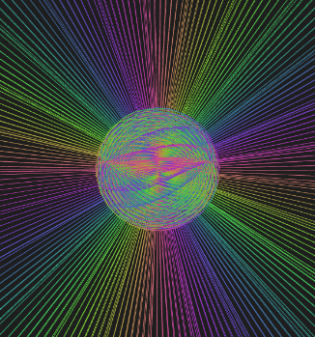

Hello!
We are group 2
And we are going to present our personal FM Synthesizer
You can find our code @ https://github.com/EllDy96/CarlGang/tree/Homework3

Slide 3
Introduction
SuperCollider implementation
Interaction design
Demo
Improvements roadmap
Index

Slide 4
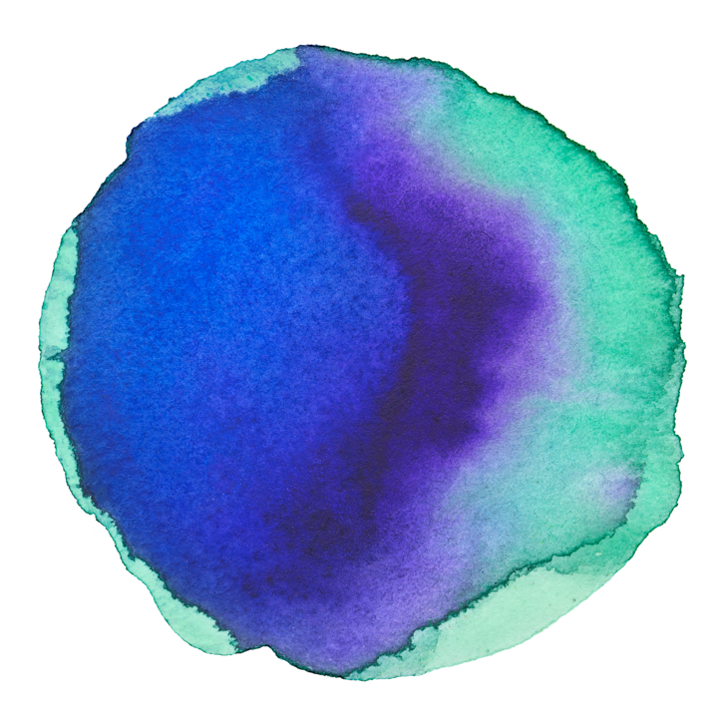
Assignment
Implement an instrument based on FM synthesis and an interface for controlling it.
1 Introduction
Implementation
Synthesis part: SuperCollider
Interaction part: ml5.js and p5.js frameworks

Slide 5
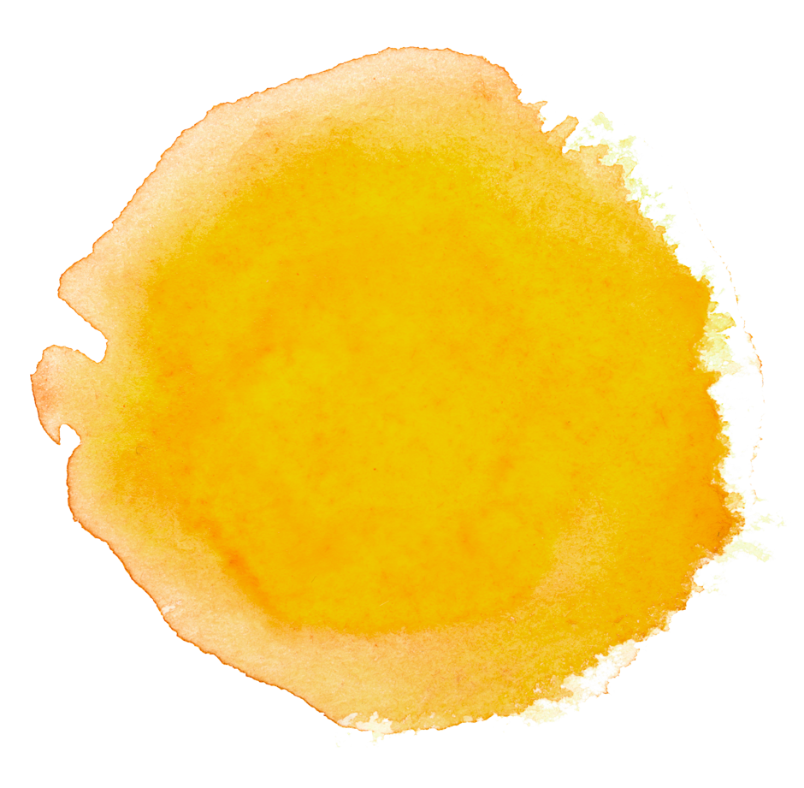
2 SuperCollider implementation
MIDI control & OSC messages

Slide 6



The FM Synthesis pattern:
Feedback Operator
Carrier oscillator
Reverb
LPF

Slide 7

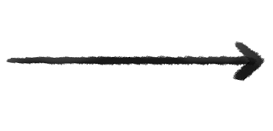


Communication Protocols:
MIDI control
OSC messages
Monophonic Synth controlled by NoteOn and NoteOff functions
4 parameters:
X centroid
feedback
Y centroid
modulation amplitude
palm-index distance
LPF cut off
palm slope
reverb

Slide 8
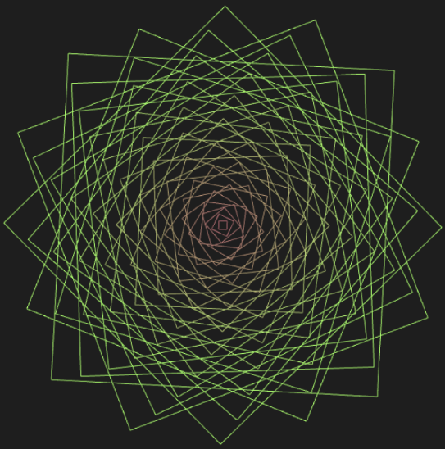
3 Interaction design
Using a pre-trained ML model from ml5.js and the p5.js framework for the animations implementation

Slide 9





Modules and libraries used

Slide 10
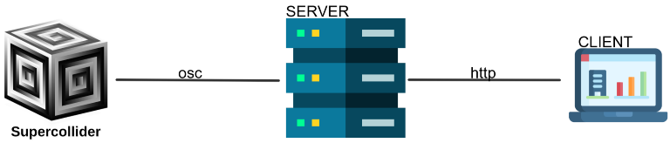
Application Architecture

Slide 11


Control Parameters
Centroid
Distace tip of the middle finger / palm base
Hand orientation

Slide 12
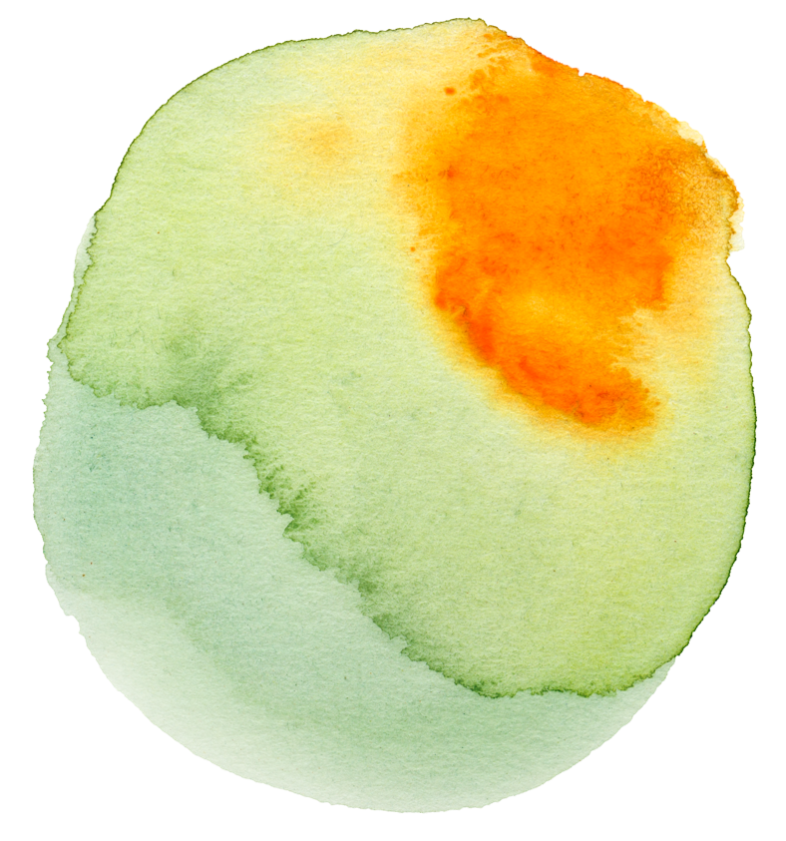
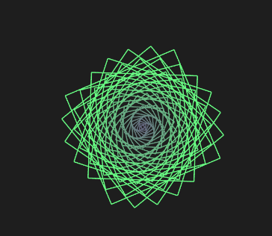
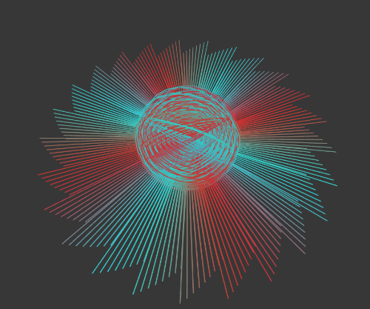

The three animations
Squared Rose
Sun Sphere
Double Square
LPF cut off frequency.
Feedback and modulation amplitude.
Reverb amount.

Slide 13

4 Time for the DEMO

Slide 14

5 Improvements roadmap
Polyphonic
Synth
More FM
Algorithms
More Synths

Slide 15
Funny facts
5000+ hours
130%
Everyone
Spent for parameters tuning
Better than our previous presentations
Will love this synthetizer

Slide 16
The End…
Thanks for your attention

